Slide 1







WHY
go to COLLEGE
INCOME:
earn 98% more per hour than those with just a high school diploma.
DIFFERENCE:
see the world, obtain new skills, and gain opportunities to help yourself and others.
HAPPINESS:
college grads report being 55% more satisfied with their work vs. 40% of non-college grads.
HEALTH:
just 1 year of college can decrease mortality rates by 15-19%.
for more go.ocean.edu/start
OCEAN COUNTY COLLEGE HUB
(732) 255-0482 • HUB@ocean.edu • go.ocean.edu/hub

Slide 2




HOW DO I
go to COLLEGE
WHERE:
  online.
  remote.
  on campus.
WHEN:
  day or evening.
  assigned class schedule.
  on our own time.
WHAT:
flexible terms ranging from 3 - 15 weeks in length.
for more go.ocean.edu/start
OCEAN COUNTY COLLEGE HUB
(732) 255-0482 • HUB@ocean.edu • go.ocean.edu/hub

Slide 3
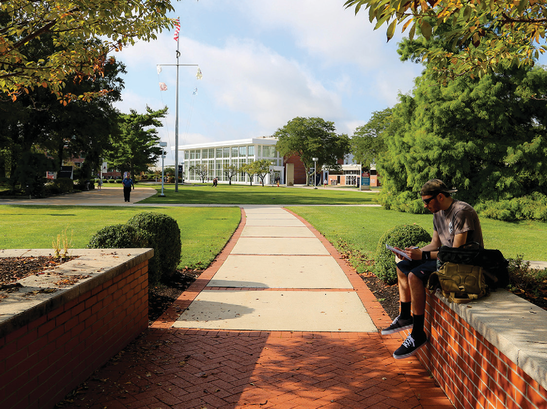






WHAT
is at COLLEGE
NURSING (click)
BUSINESS (click)
CRIMINAL JUSTICE (click)
ENGINEERING (click)
PERFORMING ARTS (click)
for more go.ocean.edu/start
OCEAN COUNTY COLLEGE HUB
(732) 255-0482 • HUB@ocean.edu • go.ocean.edu/hub

Slide 4


WHERE
DO I BEGIN
“The secret of getting ahead is getting started.”
- Mark Twain
APPLY ONLINE
FREE APPLICATION
NO ESSAY
NO COMMITMENT
for more go.ocean.edu/start
OCEAN COUNTY COLLEGE HUB
(732) 255-0482 • HUB@ocean.edu • go.ocean.edu/hub

