Slide 1
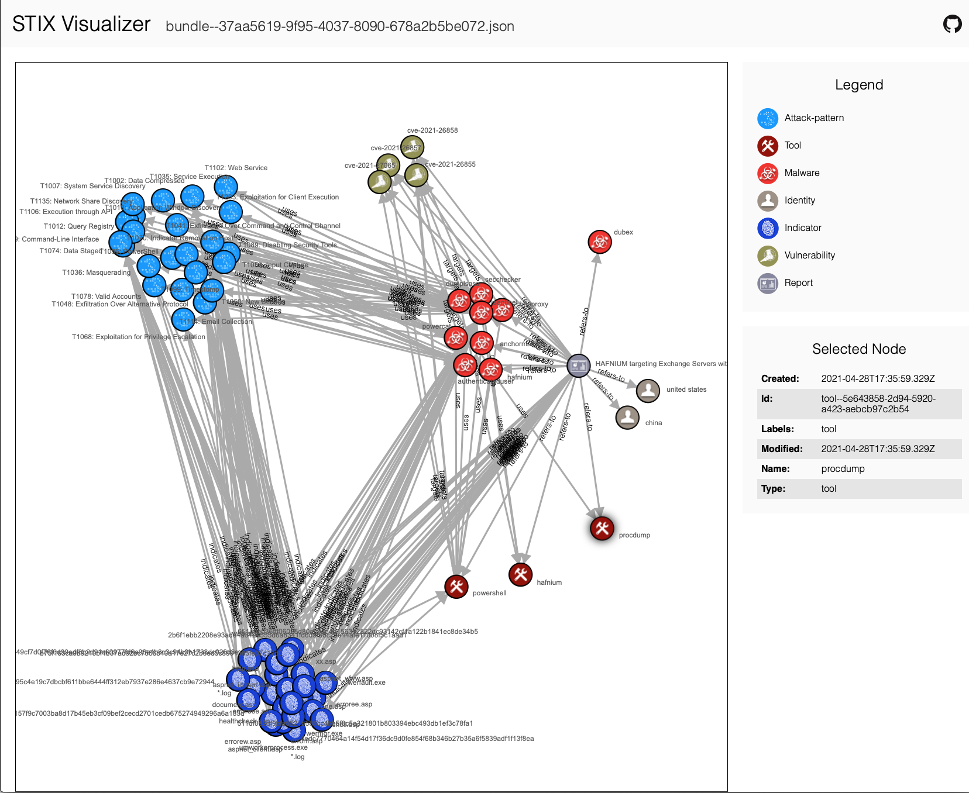
Sharing Cyber Threat Intelligence to enable Network Defense
October 8, 2021
Charlie Frick, Charles.Frick@jhuapl.edu

Slide 2
Who is this guy?
Cybersecurity researcher at Johns Hopkins University Applied Physics Lab (18 years, 12 in cybersecurity)
Specialize in security automation, machine speed information sharing, cyber risk analysis and vulnerability assessment
Also run a program to teach cybersecurity and ethical hacking to high school students

Slide 3
What are we talking about today?
Cyber Defense is currently failing to be proactive against advanced threats
Defenders struggle to match the speed and scale of attacks
Sharing Cyber Threat Information (CTI) can play a vital role for network defense, but only if it’s done in a way that enables the defender

Slide 4
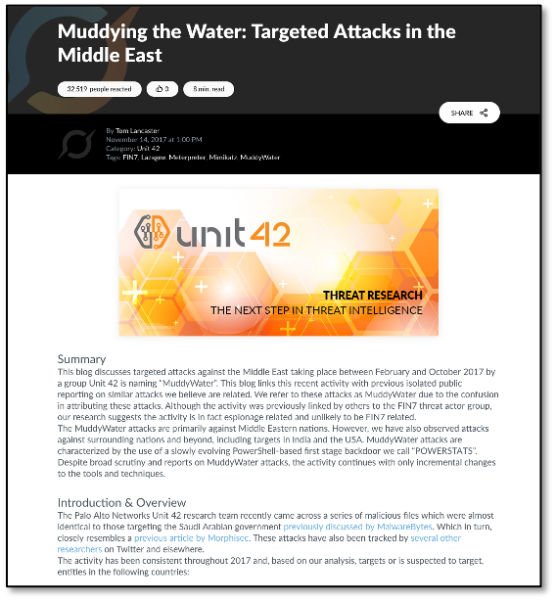
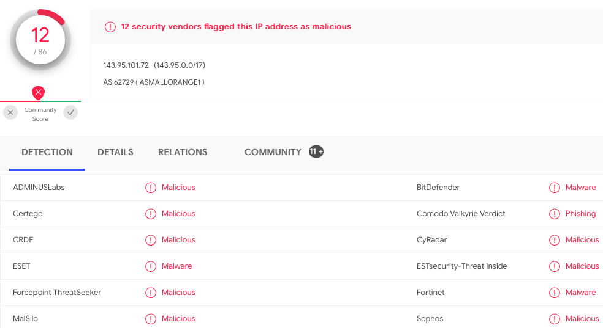
What is CTI Sharing?
Companies often participate in organizations that share CTI (Information Sharing and Analysis Centers, Vendor Feeds)
Often this data is sent as a written report that someone has to read and process to determine if they need to take action
This takes too long to help most network defenders

Slide 5
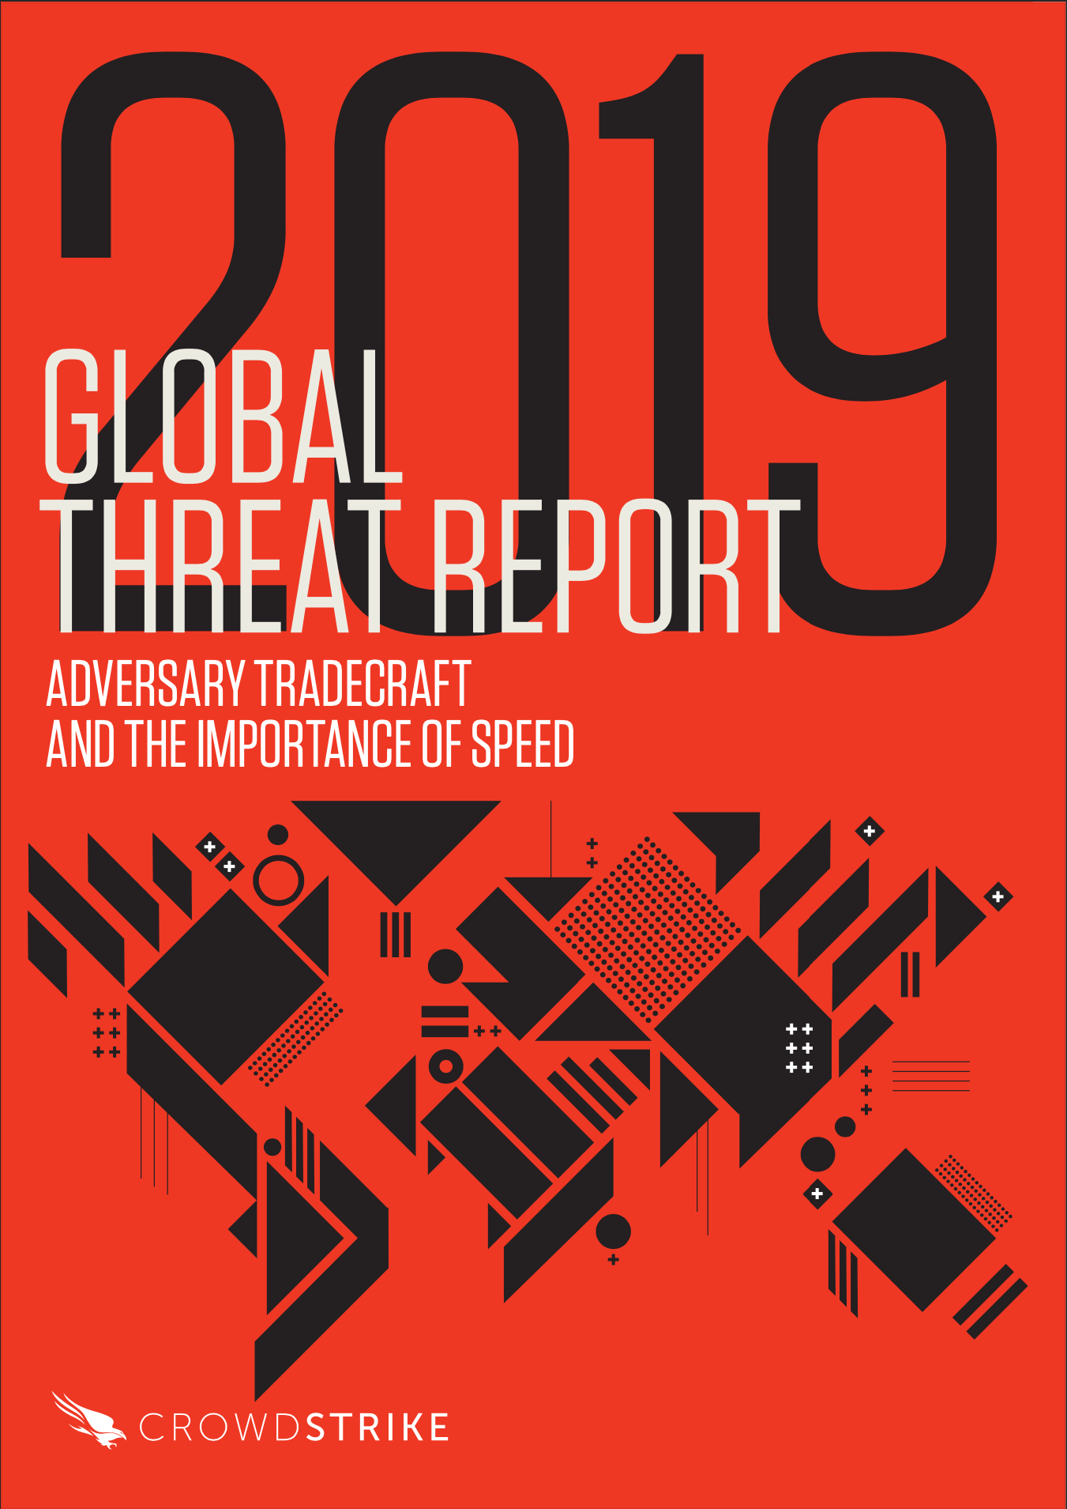
How Fast do We Need to Move?
According to the security firm Crowdstrike™, to stop an advanced attack, defenders need to:
Detect intrusions in under one minute
Perform a full investigation in under 10 minutes
Eradicate the adversary from the environment in under 60 minutes
Defenders don’t have time to read and process reports manually

Slide 6
How can we share this data fast enough to take action on it?

Slide 7
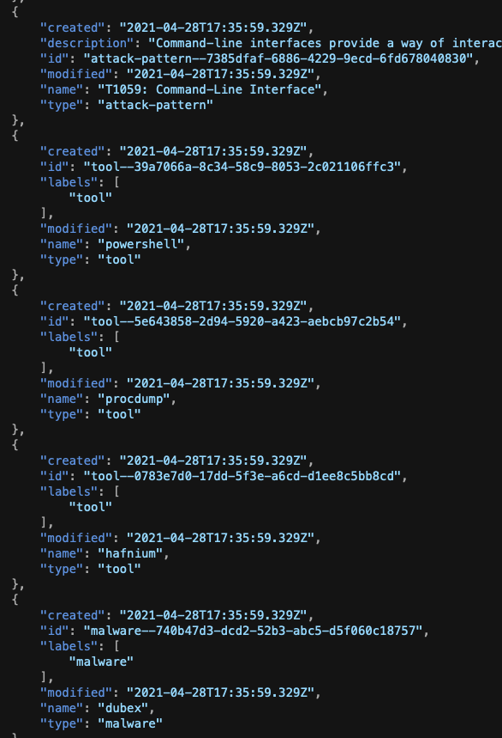
What is STIX?
Structured Threat Information eXchange
Essentially a machine readable format for CTI
v1.x was based on XML
v2.x is based on JSON
Somewhat complex set of options with the ability to add custom data fields
Version 2.x also allows for the definition of relationships which support graph-based analytics and tools

Slide 8
What Goes in a STIX bundle?
Lots of information can be formatted in STIX
Network defenders often use software to process STIX and extract information that they can use in operations
CVE to identify vulnerabilities and look for patches
Indicators of Compromise (IOCs) to block
IP address for attacker infrastructure
Bad websites/domains used in attacks
Malware file hashes (MD5, SHA1, etc)

Slide 9
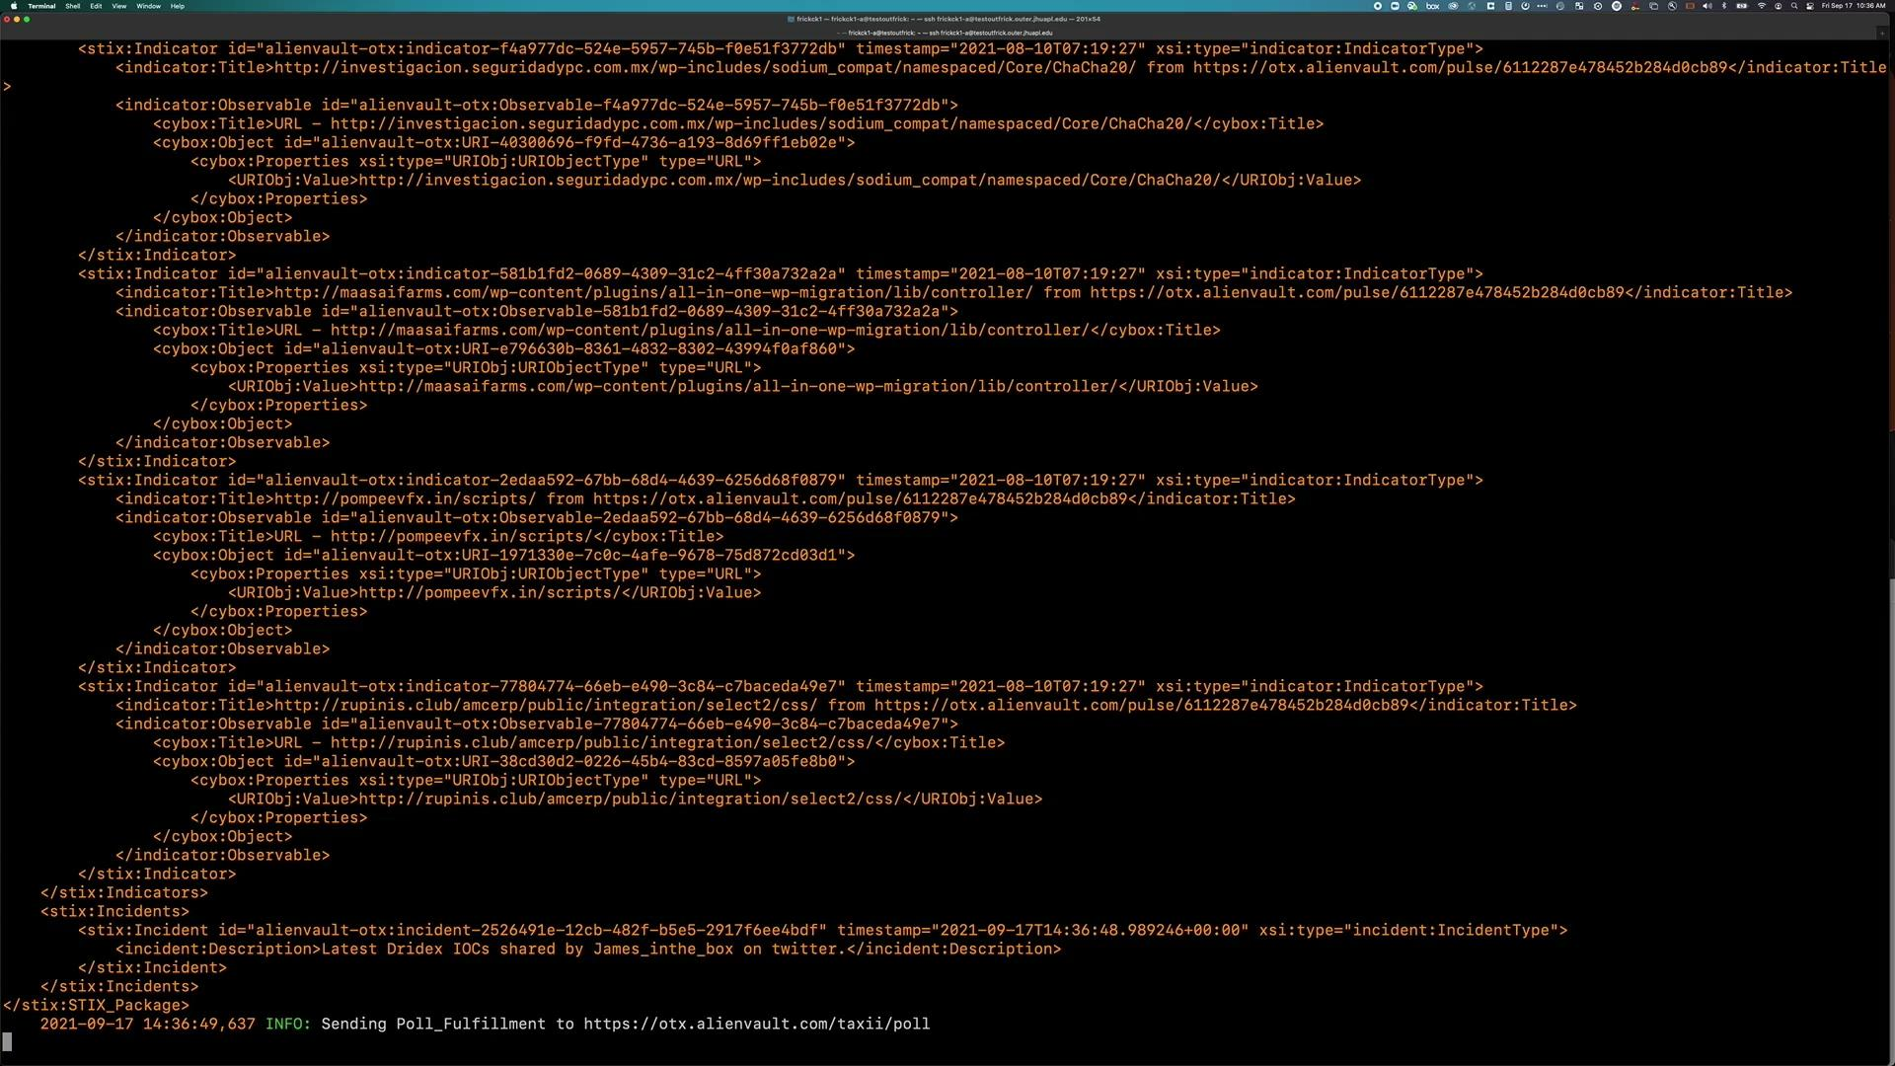
What is TAXII?
Trusted Automated eXchange of Indicator Information
TAXII provides a standard for STIX transmission
Allows multiple commercial and open source tools to know how to send and receive STIX
Can also provide secure transmission of data within a trusted circle that may want to share information within a community but not publicly

Slide 10
Combining Machine Speed CTI Sharing with Security Orchestration Enables Network Defense at Speed and Scale

Slide 11
What is Security Orchestration?
Security Orchestration, Automation, and Response (SOAR) is a method of connecting security tools and integrating disparate security systems to support security automation. It allows defenders to:
Integrate across multiple, disparate sources of information
Automate the determination of risk and the decision to act;
Synchronize those machine actions to align with an organization’s business rules and operational priorities, as captured in playbooks
Inform communities of trust via secure automated cybersecurity information exchange
One example is the Integrated Adaptive Cyber Defense (IACD) framework

Slide 12
What is IACD?
Integrated Adaptive Cyber Defense (IACD) was sponsored by the Cybersecurity and Infrastructure Security Agency (CISA) and the National Security Agency (NSA) in collaboration with The Johns Hopkins University Applied Physics Laboratory (APL)
Focused on SOAR and machine speed CTI sharing
Core research conducted 2014-2021
Continuing work throughout multiple APL initiatives and tasks
The majority of research, technical guides and best practices are freely available to the public
Frequent interactions with ISACs and their communities

Slide 13
Using SOAR, STIX, and TAXII for Network Defense
Orchestration Impacts to Operations
Average response
1 million alerts of interest
65 assigned events
56 Hours Worst Case Response
=0 Tier 1 Analyst Hours/Days to Auto-Enrich and respond to between 100 and 400 times MORE events (6500 – 26000)
How could those resources be applied?
Tier 1 Force Multiplier
Increased $ to Hire, Train, Tier 2/3 Analysts who Design/Automate Advanced Mitigations
30-60 seconds to Act
24 – 96 Tier 1 Events Simultaneously

Slide 14
Using SOAR, STIX, and TAXII for Network Defense cont.
Indicator from pilot feed arrives at TAXII Client
Orchestrator gathers additional enrichment reputation of IOC
Orchestrator checks IOC against organization whitelists/blacklist
Automatically ignored if whitelisted
Verify block if blacklisted
Orchestrator searches logs for network workstation/servers with connections to IOC in last 30 days.
SOC analyst reviews ticket and sends Course of Action (COA) to Orchestrator

Slide 15
This still isn’t enough!
Processing IOCs and CVEs through machine speed CTI sharing and SOAR dramatically improves network defense
For those Use Cases
We still need more to meet that “1-10-60” challenge

Slide 16
Why we Need to Share more
Here is a visualization of a STIX bundle shared for a recent (2021) campaign against Microsoft Exchange servers (Hafnium)
What information in this bundle can automation take immediate action on?
Patch the CVEs
Block the IOCs
Let’s discuss why this may not be enough to protect against ongoing and future attacks?

Slide 17
Ongoing Research: Behavior Objects
Machine Opens Suspicious Email
PowerShell Run for the First Time
Utilize STIX, TAXII, and SOAR to share information that can be automated to address the parts of attacks that get reused
Represent higher level data than an IOC
Also more specific than an overall tactic or technique
Most will be a sequence of events that when detected together can enable a response
Machine Registry Modification
System Level Process sends suspicious traffic

Slide 18
Summary
Thank you for your time today
Our collective defensive community needs a lot of help against cyber attacks
CTI sharing can enable network defense when used properly
There is still much to do and we need your help

