Slide 1
WPE Instructor Meeting January 17th, 2024
Workforce & Professional Education

Slide 2
Workforce and Professional Education Department Meet the Staff
Dr. Joseph Konopka– Vice President, WPE
Sherry Shearer – Assistant to the VP of WPE
Virginia Biase – Director of Employer Partnerships
Gerald Mangino – Manager of Career Training Programs
Chris Brittain – Operations Manager
Tina Davis – Instructional Designer

Slide 3
What is WPE?
Ocean County College’s Workforce and Professional Education (WPE) department offers specialized certifications to help students start a new career or become an expert in their current occupation.
We offer opportunities for fast-track career training leading to immediate employment upon program completion. Our training programs run from three to six months and can be used as a successful career ladder to further educational growth.
We offer classes in the following areas:
Healthcare
Business
Technology and Computer Science
Culinary Foundations
Alternate Route to Teaching

Slide 4
New Location
Hovnanian Health and Human Services Building (Building 4)
Main Office - Room 103
Continuing Learning Center (Building 4)
Adult Basic Education
ESL

Slide 5
Policies and Procedures
Email Policy
WebEx
Contracts
Leave Requests
Payroll
Grade Input
Additional Updates

Slide 6
WPE Email Policy
Instructors must use their ocean.edu email accounts. OCC policy dictates that we are not able to respond to emails from personal email accounts.
WPE Instructors are expected to check their ocean.edu accounts on a regular basis to ensure regular communication with both students and administration.

Slide 7
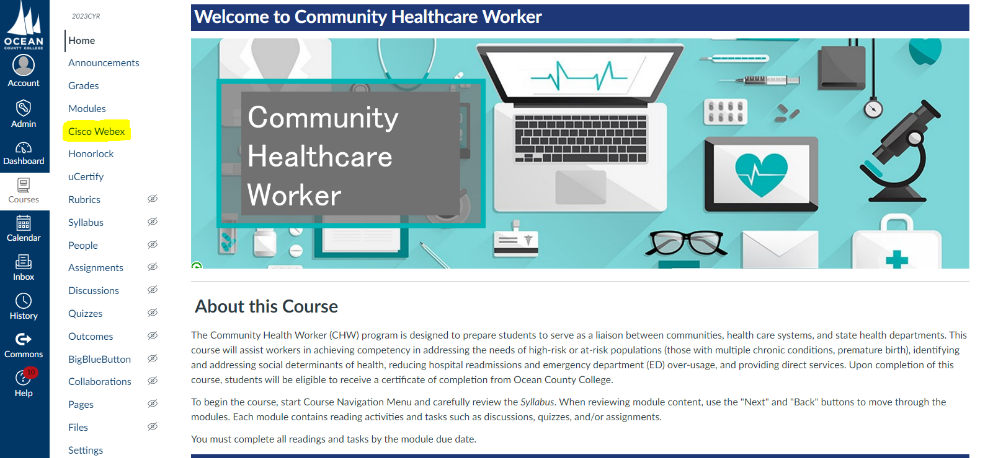
WebEx for Synchronous Meetings
WebEx is the required video communication tool of Ocean County College.
For security reasons, Zoom meetings and other platforms will not be accepted.
We recommend setting up all WebEx meeting links at the beginning of each course.

Slide 8
Contract Process
Contracts are now housed in NeoEd.
Links are sent via email from Human Resources.
Contracts include course title, section, dates, and pay rate. Dates are subject to change based on enrollment and do not require a re-issued contract.
Instructors have 7 business days to respond with digital signature by signing into NeoEd and completing the form (hand-written signatures are no longer accepted)

Slide 9
Contract Process
CEU = 10 hours of instructional time
WPE Instructor II
Full enrollment - $458/CEU
Low enrollment - $288/CEU

Slide 10
Scheduling and Leave Requests
Course schedules should be determined prior to the contract request.
Instructors should take into account holidays and pre-planned vacations, scheduling around these dates to encompass all clock hours within the course.
There is no paid vacation time for WPE instructors.
Instructors that are absent from a class will be required to schedule a make-up class so the required class hours are met for the term or provide an adequate assignment substitution.
Make ups classes can be done virtually

Slide 11
Sick Leave
Leave Requests and Leave Approvals are now available in the Self-Service Portal for Faculty & Staff Portal for Vacation, Sick, and Personal Leave Requests.
All employees should begin using the paperless system immediately. Please see the attached instructions for guidance.
Beginning 10/1/23, Human Resources will no longer accept paper Absence Reporting Forms.

Slide 12
Payroll Deposits
Payroll takes place via direct deposit every other Friday.
Once a payroll requisition is submitted, you will receive an email alerting you of the total amount and the dates of deposit.
Course pay is deposited evenly over one or more pay periods depending on the course length.
The first payroll deposit takes place after the course start date.
The final deposit takes places on the first pay date following the final date of the course.
Log in to Self-Service for Faculty and Staff to view paystubs.

Slide 13
Grade Input
WPE Courses are Pass/Fail. Students will be given a grade of ‘S’ (Satisfactory) or ‘NS’ (Not Satisfactory)
Going forward, all WPE instructors are required to submit grades by the final date of the course.
Although the system allows partial grading to be submitted, course grading will not be considered complete until all grades are entered.
Once you enter grades, they are official, and will be available to the students to view.

Slide 14
Grade Input
Log into Ocean Connect
Select “Self-Service for Faculty and Staff”
Click “Faculty”
Click the correct section
Navigate to “Grading > Final Grade”

Slide 15
Additional Updates
Instructor Observations will take place annually
Program Sheets – please send info to Chris by the end of the week.
Exams should be scheduled 2 weeks prior to the course start date. Communicate dates with Jerry.
Professional Development Opportunities

Slide 16
Professional Attire
Business/ Business Casual
Scrubs or lab coats approved for Allied Health Instructors

Slide 17
Ocean Connect

Slide 18
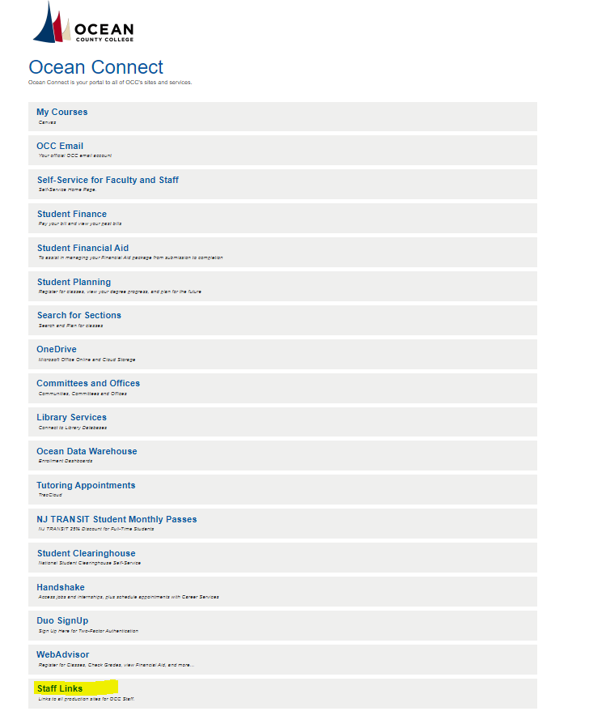
NeoEd Tasks
Log-In to NeoEd through Ocean Connect to access required annual trainings.
NeoEd will soon include a repository of all WPE guides and manuals.

Slide 19
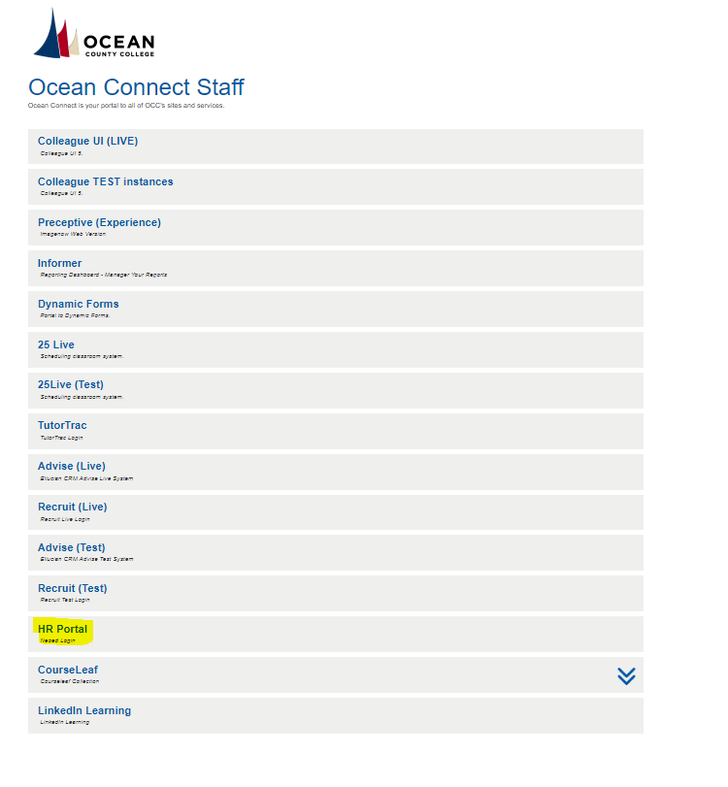
NeoEd Tasks

Slide 20
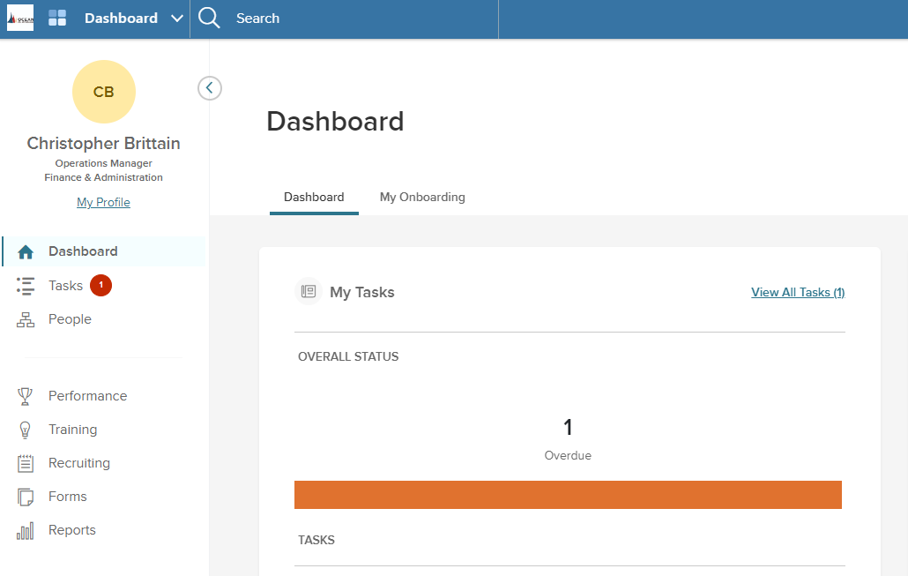

Slide 21
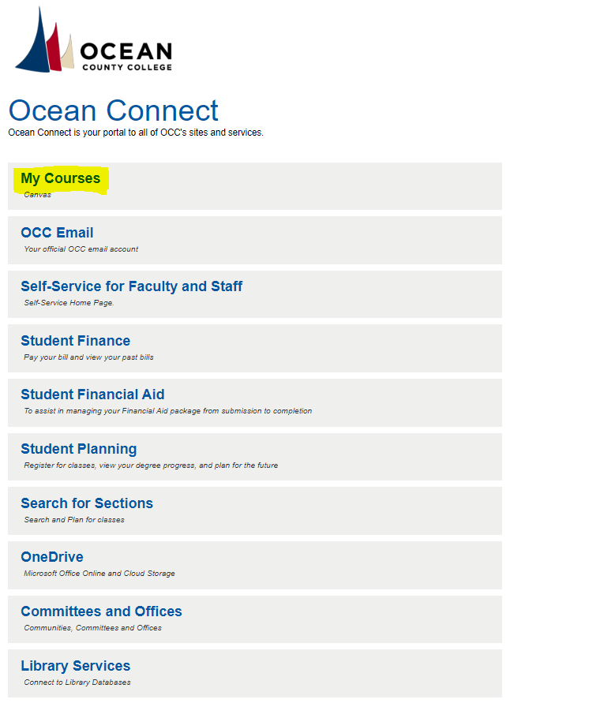
Canvas

Slide 22
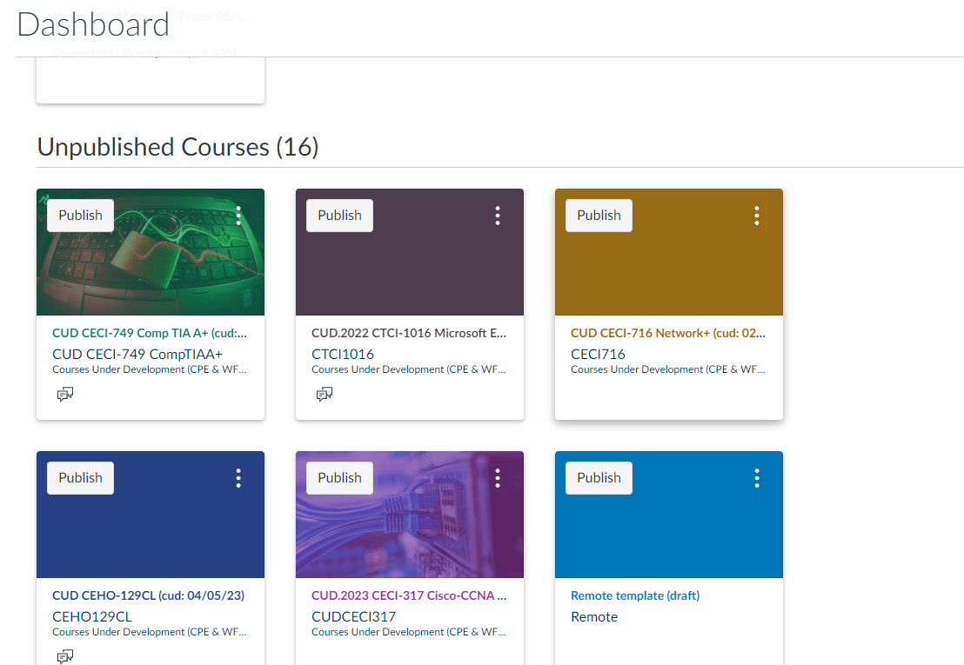
Canvas
Once you are in Canvas you will be in your Dashboard, scroll down to Courses, click on Unpublished Courses. Select the one you want edit.
Note: Your course can not be published until you have published your syllabus in Simple Syllabus.

Slide 23
Student Satisfaction Survey
Going forward, the anonymous Student Satisfaction Survey deployed by Watermark will be embedded into each Canvas shell.
Students will not be able to complete their course until they have filled out the survey.
Pop-up reminders will appear each time they log in toward the end of the course.
Please remind and encourage your students to complete the survey in the final week of the course.

Slide 24
Convert Credentials to Credit
Certain courses within the WPE department can bridge to a student’s academic transcript and can be utilized as credit toward a degree.
In order to transfer WPE credit, students must fill out the Prior Learning Credential to Credit Application.
This can be found on our FAQ. If this applies to your course, please encourage your students to take this opportunity.
Students must apply to OCC - https://www.ocean.edu/admission_and_aid/apply-now/
This will soon be a simple process through a dynamic form.
Notes:
Link to website course list: https://www.ocean.edu/programs-and-courses/wpe-course-list/

Slide 25
Convert Credentials to Credit
Noncredit Course | Credit Area | Credits Earned
Certified Clinical Medical Assistant | General Education | 9 – 16
Certified Nursing Aide | General Education | 2
Community Health Worker | Social Work SOWK 191, SOWK 192, SOWK 194 | 9
EKG | General Education | 3
Patient Care Technician | General Education | 3
Pharmacy Tech | General Education | 1
Phlebotomy | General Education | 4
Advanced Project Management | ENGT 196 | 3
Culinary Foundations | Hospitality | 6
Google IT Help Desk Support | Computer Science CSIT 100, CSIT 185, CSIT 144, CSIT 200 | 12
Quickbooks | Accounting | 1
Notes:
Link to website course list: https://www.ocean.edu/programs-and-courses/wpe-course-list/

Slide 26
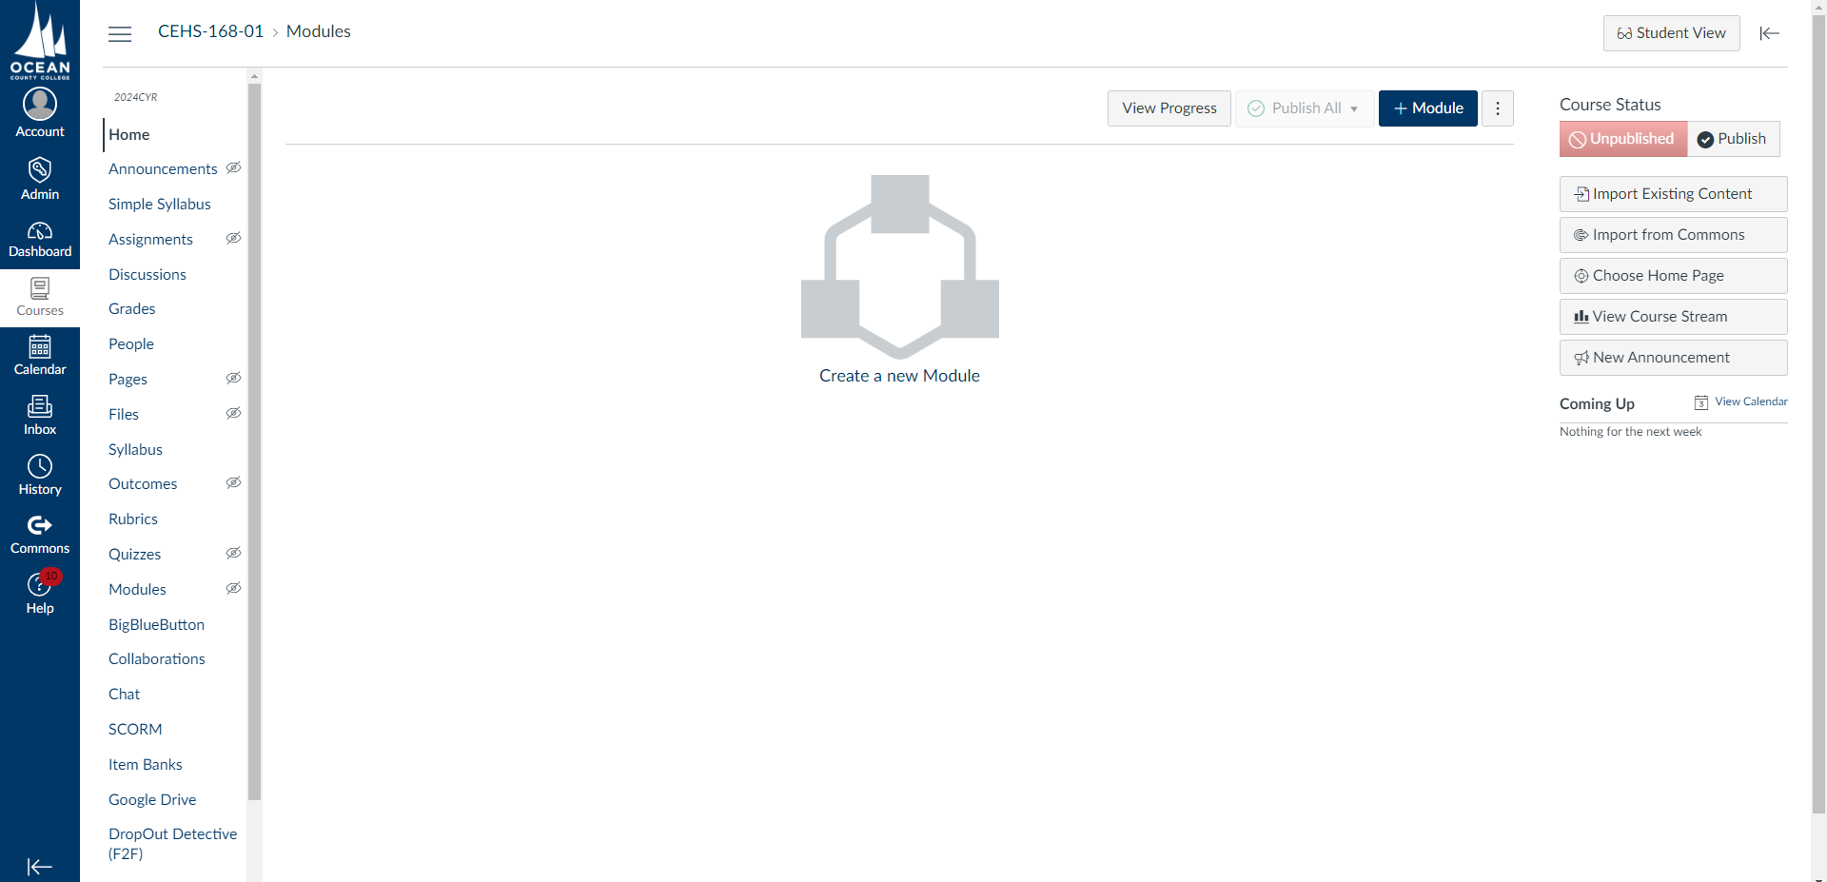
Simple Syllabus

Slide 27
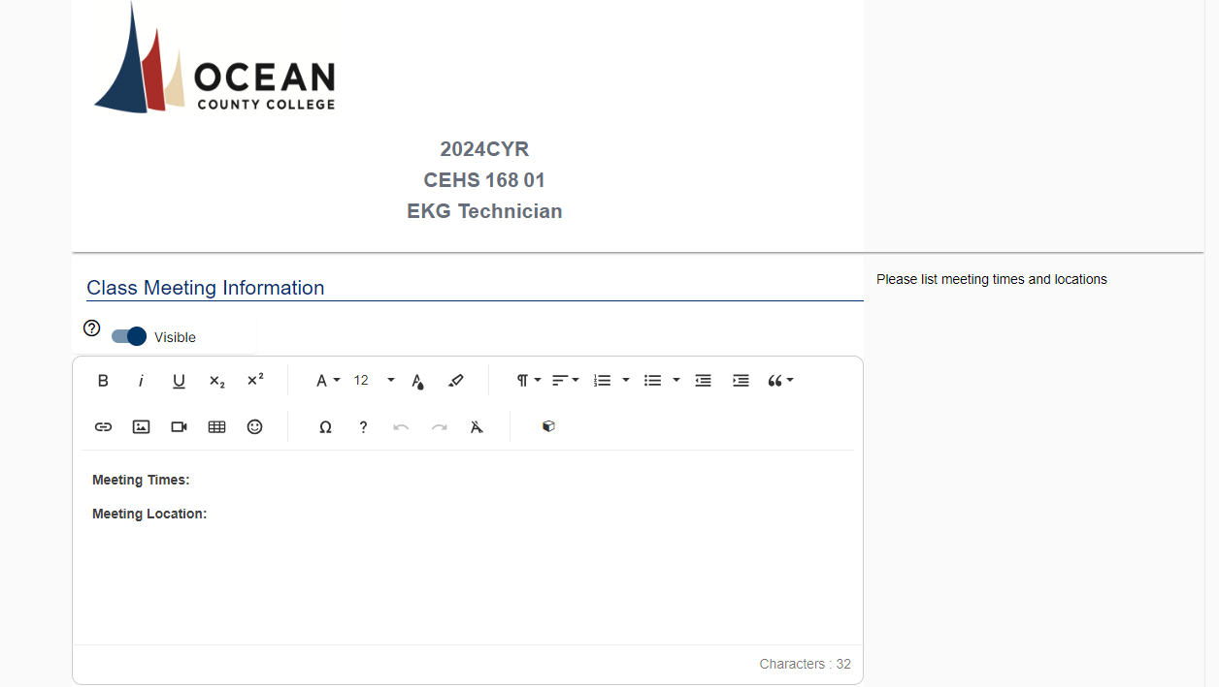

Slide 28
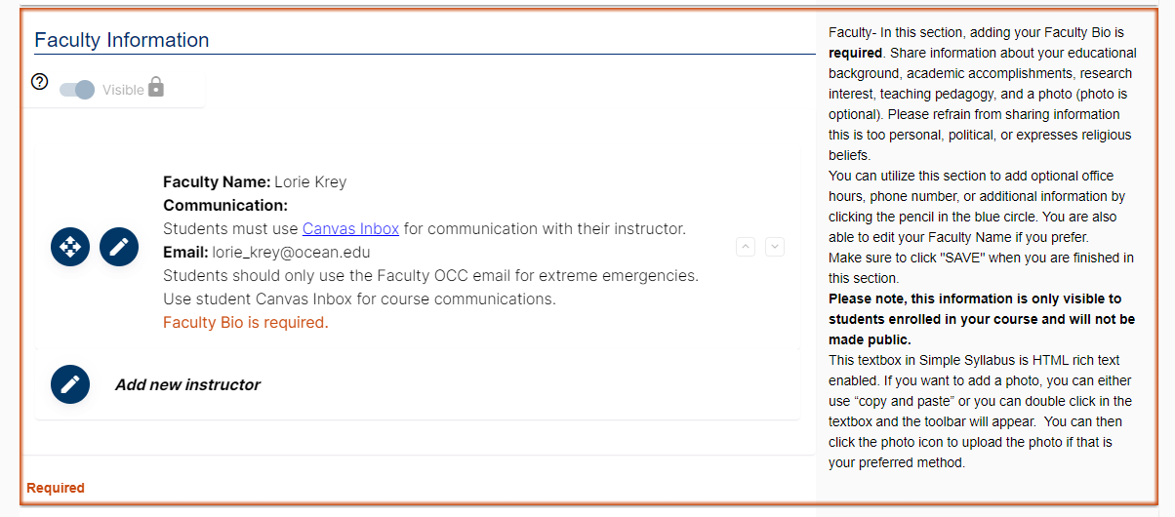

Slide 29
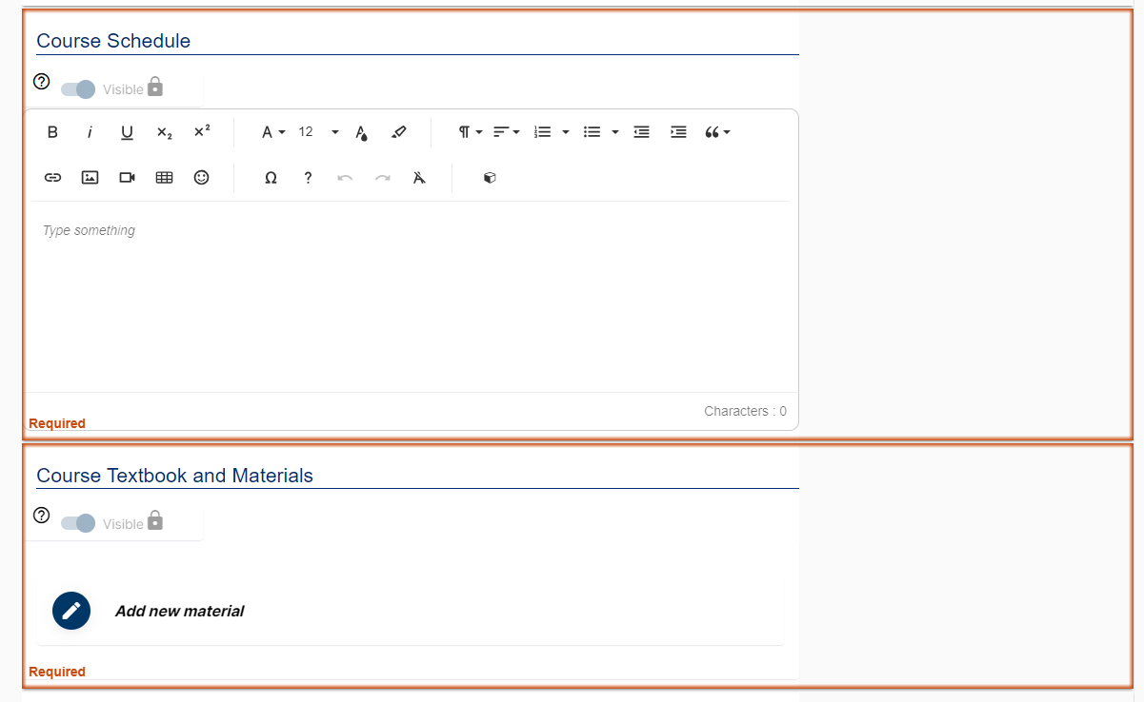

Slide 30
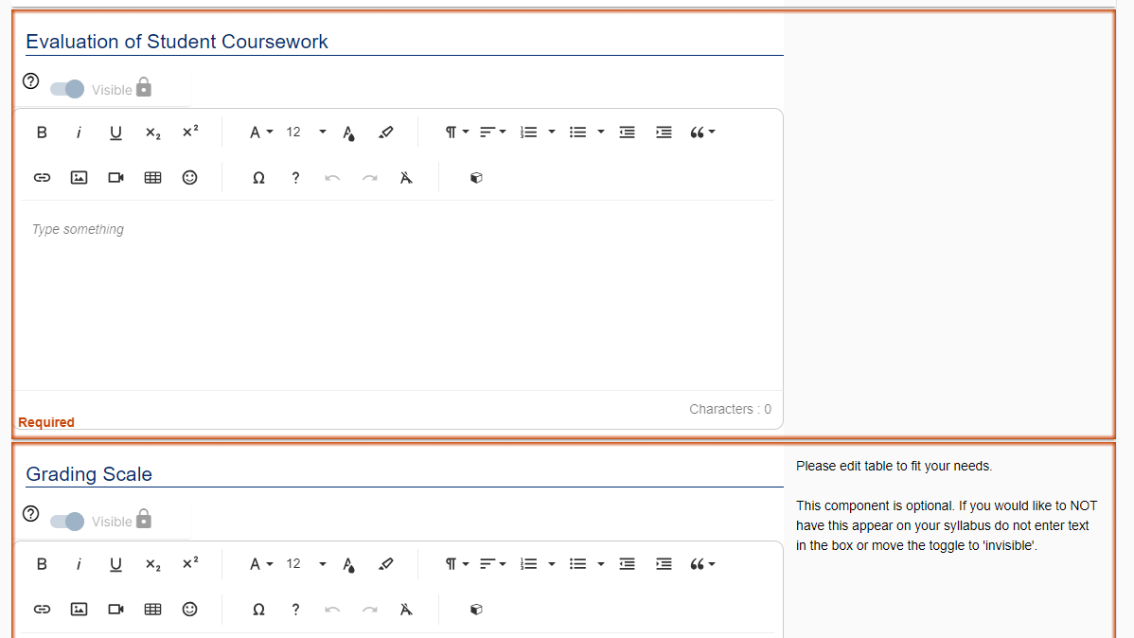

Slide 32
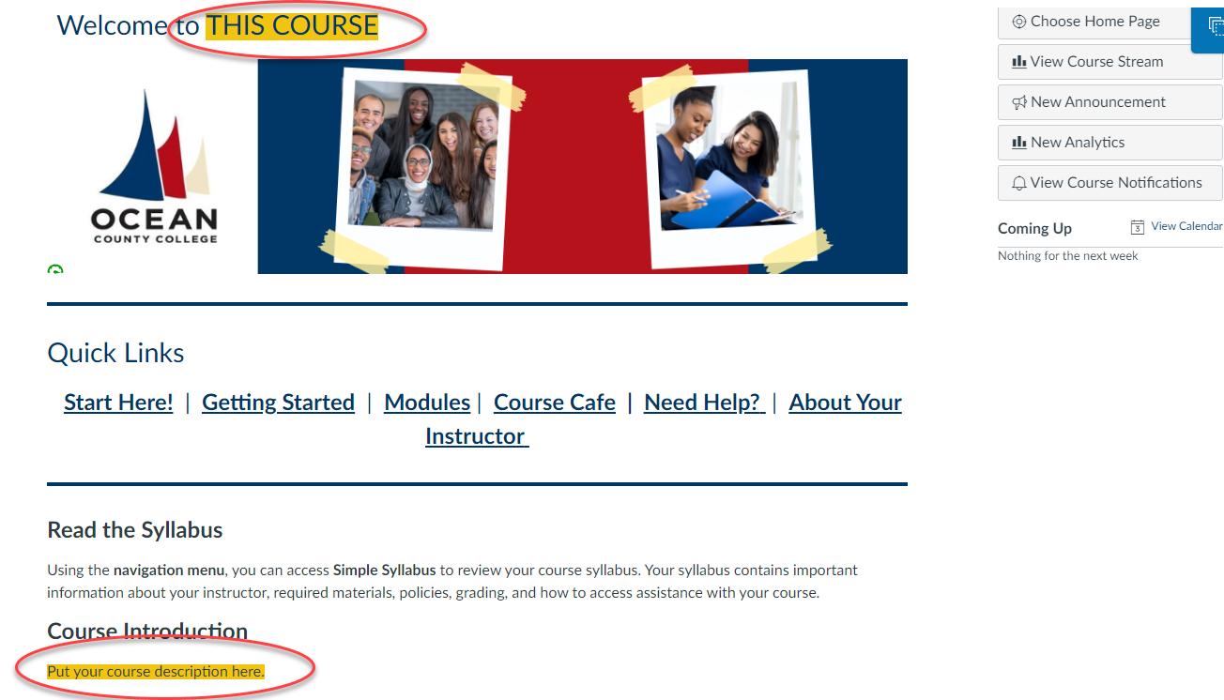
Canvas Template
Your course will be given a template to customize. Email Tina Davis – tdavis@ocean.edu for assistance

Slide 33
Helpful Links
Explore the list of available programs and certifications: go.ocean.edu/wpe
Course Registration: go.ocean.edu/WPEPrograms
Email or call us with any questions: Christopher_brittain@ocean.edu
(732) 255-0400 x2549

Slide 34
Open Office Hours
Assistance with Canvas and Online Course Development - Tina Davis - Email for appointments – tdavis@ocean.edu
Onboarding Assistance, Contracts, Payroll – Chris Brittain – Tuesdays 10am-12pm.
Email for appointments – christopher_brittain@ocean.edu

Slide 35
Questions?

