Slide 1

Colloquium Spring 2026

Slide 2

Ocean County College Foundation
The Ocean County College Foundation is proud to share several significant accomplishments from the past year:
Record Support for OCC Community
We distributed an unprecedented $2 million in scholarships and programmatic support to students and campus initiatives.
Legacy Campaign Milestone
The Legacy Campaign has reached $5 million in gifts and pledges toward our $25 million goal, ensuring long-term funding for OCC scholarships and programs well into the future.
Expansion of the Foundation Art Collection
Featured artists can be viewed on our website: occfoundation.org.
Increasing Scholarship Demand
Scholarship applications for Spring 2026 have surged by over 50%, underscoring the critical need for student support.

Slide 3
Ocean County College FoundationLeadership Updates
New Fund Request Timeline
To ensure effective stewardship, the Foundation Fund Request period will now run March 1-April 30 annually, with awards beginning July 1 in alignment with our fiscal year. Requests will be evaluated based on alignment with the Foundation’s Pillars of Support and the College’s Strategic Goals.
Leadership Updates
We are pleased to announce Casey Yetman as our new Foundation Board Chair. Additionally, we have welcomed three new members to the Board of Trustees:
Briann Skiba, OCC Class of 2018
John Shaffer, OCC Class of 2009
Steven Zabarsky, OCC Board Chair

Slide 4

Helping Hands Food distribution
Visits to Helping Hands | Summer | Fall | Spring | Total
FY22 |  | 316 visits | 297 visits | 693 visits
FY23 | 18 visits | 884 visits | 1,152 visits | 2,054 visits
FY24 | 151 visits; 42 unique | 1,866 visits; 320 unique | 3,012 visits; 506 unique | 5,029 visits
FY25 | 304 visits; 84 unique | 4,076 visits; 718 unique | 3,202 visits; 608 unique | 7,582 visits
FY26 | 335 visits; 139 unique | 4,263 visits; 1005 unique

Slide 5
Helping Hands Donors
We appreciate all the generous donations and are grateful to continue to be a Hunger-Free Campus Community:
NJ Hunger Free Campus Grant
Stop & Shop
OceanFirst Foundation
Snyder’s-Lance Warehouse
Frank Dupignac
Dr. Sadia Sheikh
Stephan Caldwell
Lauren Dix
Mike Farragher and a 55+ community
Athletics
EOF
Counseling
Disability Services
Registration & Records
The Hub
Success Team
School of Business & Social Sciences
Barnegat Bay Partnership
...and lots of individual donors and supporters!

Slide 6

Tutoring Center Usages
Fall 2025 Semester
Total # of tutoring sessions: 2,065
Total # of unique students: 675
Total # of sessions in the Writing Center: 1,001
Total # of English I (ENGL-151) sessions: 555
Total # of sessions in STEM Center: 398
Total # of Intro to Statistics (MATH-156) sessions: 145
ELL Conversation Cafe: Throughout the Fall 2025 semester, the Tutoring Center and Writing Center collaborated with the Arts and Humanities Department to support the ELL Conversation Cafe sessions by offering a dedicated space and tutors who actively engaged students in conversational practice. This initiative provided meaningful engagement and connection for both staff and participating students, and we look forward to continuing to support opportunities that foster student growth and retention.

Slide 7
Arts and Humanities Collaborations and Accomplishments (Slide 1 of 2)
New credit ESL Program Launch
ELL Conversation Cafes
Banned Books
SKD Free Speech Event
Arts On Campus Tutoring Center Unveiling
International Education Week Presentations
"The Strength of Song and Dance" featuring Ty "Dancing Wolf" Ellis
A Century of Fitzgerald's Masterpiece: The Great Gatsby at 100
70th Anniversary Celebration of J.R.R. Tolkien's The Return of the King
ASL Rock & Roll Show
Friday Music Afternoon Recital Series

Slide 8
Arts and Humanities Collaborations and Accomplishments (Slide 2 of 2)
New concentrations in Films Studies, Comm Studies, Photography, and English/History Education
Redesign of Broadcast/Production to Media Studies
Shakespeare's Whistleblowers Presentation
The Free School - The Faces of Faiths: A Journey through World Religions
AI & Assessment Community of Practice
Music Practice Suite Open House
Music Program Recitals & Open House
Student Photography Gallery: "What Could Be: An Alternative Processing Exhibition"
OCC Repertoire Theatre: Dracula and Broadway for the Holidays 5
Art Club at Smithville Art Walk

Slide 9
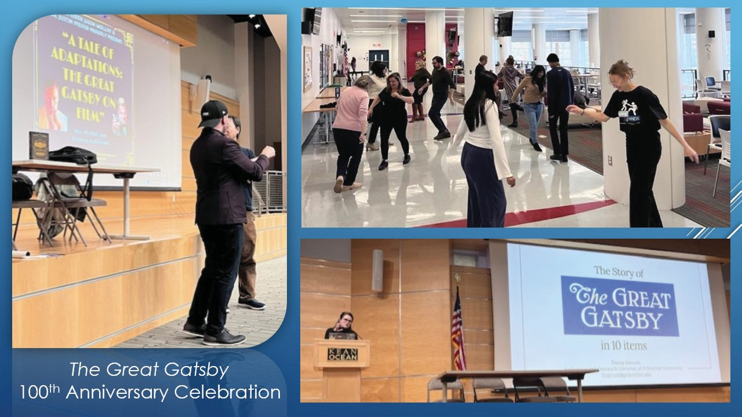
Students at Great Gatsby event

Slide 10

Students and professor performing sign language at the ASL Rock & Roll Show

Slide 11
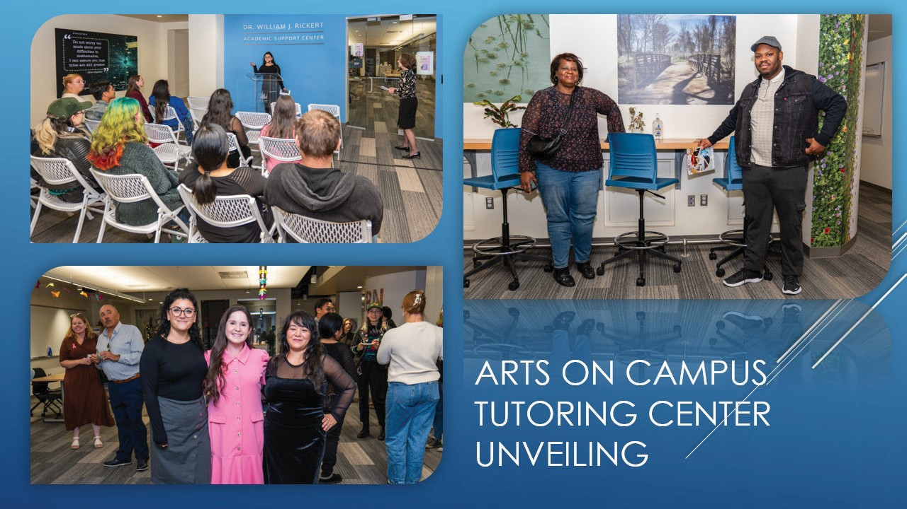
Student artwork unveiling at the Tutoring Center

Slide 12
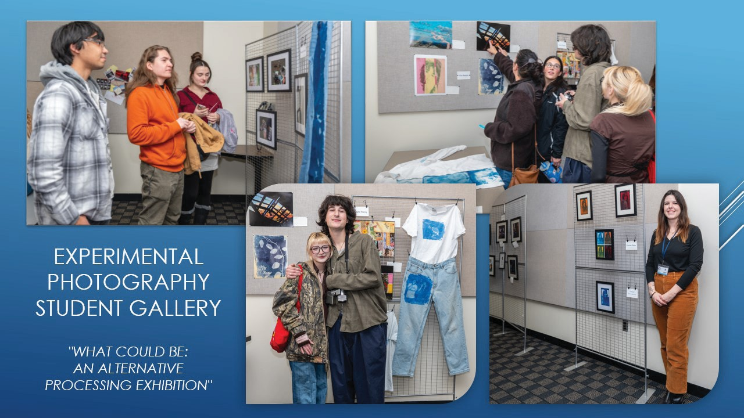
Experimental photography Student Gallery

Slide 13
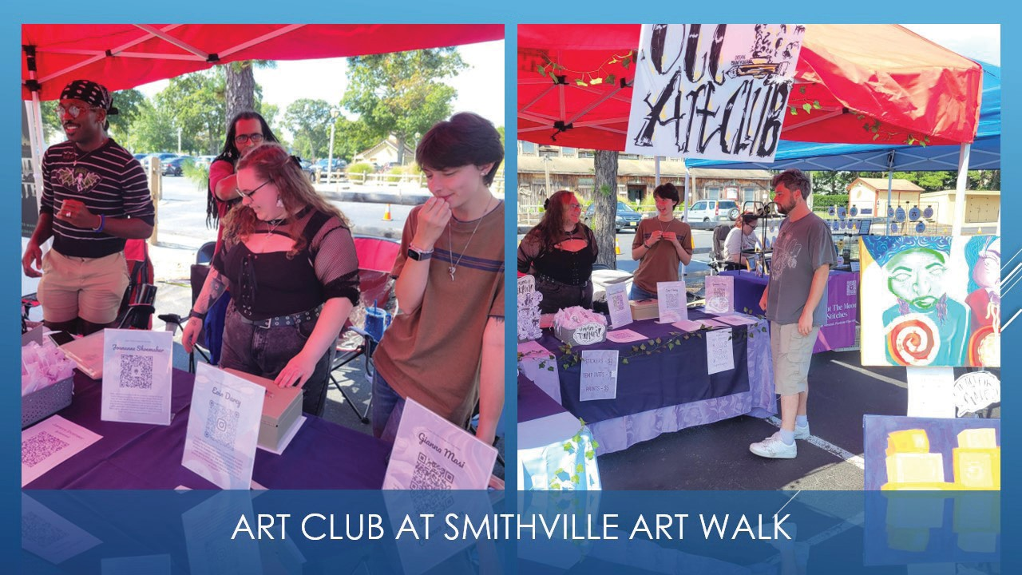
Art Club at Smithville Art Walk

Slide 14
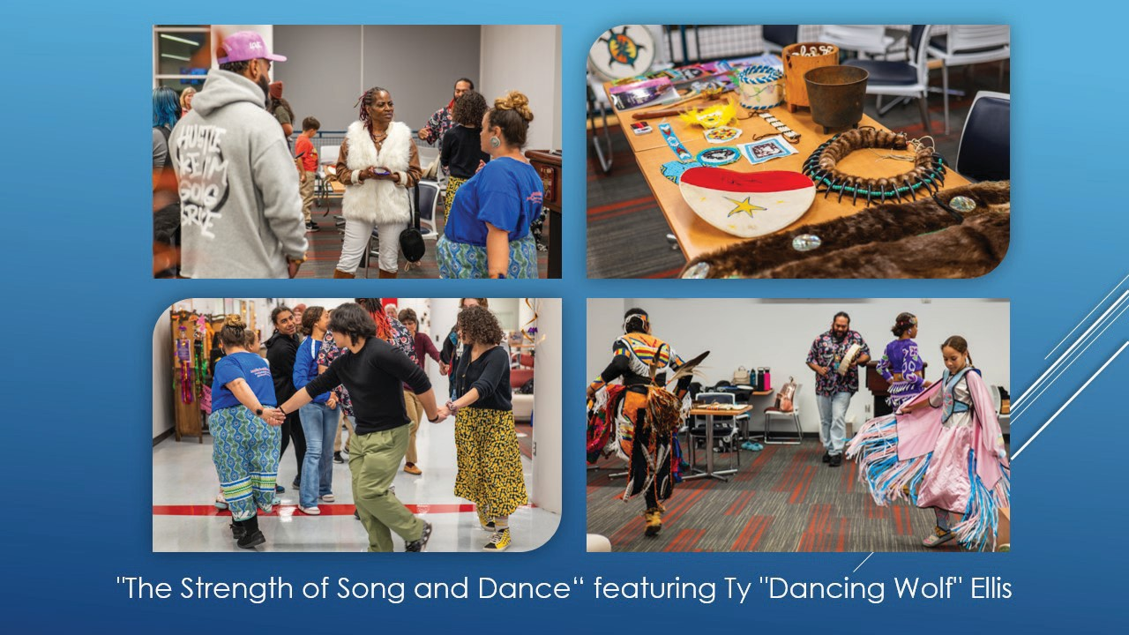
The Strength of Song and Dance featuring Ty "Dancing Wolf" Ellis

Slide 15
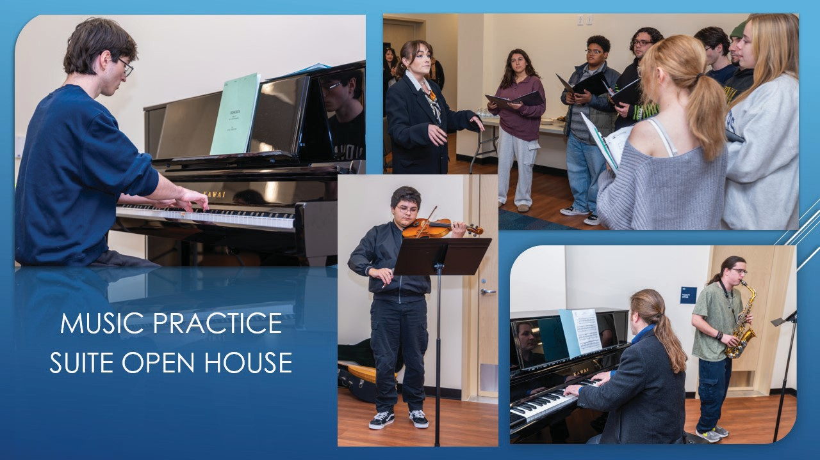
Music Practice Suite Open House

Slide 16
Gruni Center Rennovation
Thanks to outside donors, The Jay and Linda Grunin Center for the Arts has had some much-needed refreshing with new paint, floors, restrooms, and the upgraded Bösendorfer Room.
The lighting on the main stage has been upgraded to incorporate LED lights, offering a wider range of theatrical lighting possibilities.
A long-awaited audio system upgrade will provide a better and more consistent listening experience throughout the entire theater.
The Grunin Center’s Schools ‘n’ Stage student matinee series had 1,093 students from 13 Ocean County schools and 3 community groups attend performances by Calpulli Mexican Dance and The PAZA experience, thanks to the support of the Ocean County Cultural & Heritage Commission and the Ocean County College Foundation.

Slide 17

Robert J. Novins Planetarium
The Robert J. Novins Planetarium continues to increase its reputation as a science hub in Ocean County with family programming through the NASA Anchor Grant. Over 279 people registered for the International Observe the Moon night activities, including 130 who attended the premiere of the film Forward! to the Moon. This represents a large increase over the previous year’s attendance.

Slide 18

Early College
Early College
The Early College team established partnerships with four new partners for the Fall 2025 term, including two private schools, Maayan Academy and Ocean Academy Charter School, as well as two schools in Monmouth County: Raritan High School and Ocean Township High School.
2,238 high school students elected to take Ocean County College classes for credit during the fall term (including early college terms and on-campus terms). This represents a 2.8% increase over last year. These high school students are taking/took 15,137 credits, an increase of 8.2% over the same period last year.

Slide 19
Recruitment
Recruitment
The Recruitment Team completed 18 College Pathways presentations in both English and Spanish at local high schools for the Fall 2025 term, as well as 2 virtual presentations for non-traditional students, parents, and community members.
The Recruitment Team met with over 3,000 potential students in the Fall at events ranging from freshman seminar visits to the college, back-to-school nights, early college information sessions, and events geared toward students in the foster care system, homeschooled students, and alternate high school students.
The Recruitment team also hosted several large-scale events, including the annual Fall Open House, the 2nd annual Trunk or Treat event on campus, drawing over 300 attendees, as well as the Guidance Counselor breakfast in October, which had attendees from three different counties to learn more about OCC and the opportunities available for high school students.

Slide 20
Success & Retention
Success & Retention
The Student Success Team made nearly 12,000 outgoing calls during the Fall 2025 semester. They spent almost 200 hours on the phone assisting current students with various concerns and situations throughout the term.
Out of the total student population for Fall 2025, 49.7% of students had an alert raised due to either a faculty member flagging or a low course average. This represents a 6.3% increase over last year. Last Fall, 36 instructors utilized the early alert system; 72 instructors raised flags on students of concern this fall.

Slide 21
Success & Retention Continued
Success & Retention
The Student Success team supported numerous on-campus initiatives, including the Disability Fair, the Game of Life with TRIO, the Tolkien event, Kean Ocean Open House, Fall Fest, Stay Late at 8, and more. The team collaborated with instructors Lynn Kenneally and Jeff McWeeney to present the Game of Life – Pizza edition to Business classes, as well.
In September alone, the Student Success Team completed 43 visits to STSC sections to discuss college support options with new students. Following the visits, the team conducted an additional 38 resource tours, which showed students where they could find support services on campus, including Tutoring, the Library, EOF, and more.

Slide 22
FIPSE (Fund for the Improvement of Postsecondary Education)
FIPSE (Fund for the Improvement of Postsecondary Education)
Sponsored by the FIPSE Basic Needs Grant, the Missouri CAN Poverty Simulation was delivered 3 times during the Fall semester, both on and off campus.
More than 30 members of Hackensack Meridian Health at JFK Medical Center participated in the simulation as part of the Young Professional Program in Organizational Leadership.
Almost 50 guidance counselors from Ocean and surrounding counties participated in the simulation at OCC’s main campus as a part of the annual Guidance Counselor Breakfast.
During the Faculty Learning Institute in August, nearly 25 faculty members, deans, and staff participated in the simulation.

Slide 23
FIPSE (Fund for the Improvement of Postsecondary Education) Continued
FIPSE (Fund for the Improvement of Postsecondary Education)
An additional 5 staff members were trained to facilitate the Missouri CAN Poverty Simulation, bringing the total to 7 certified facilitators at Ocean County College.
The FIPSE basic needs grant had 125 active participants in the Fall 2025 term. Direct student spending was $48,918.95 for the term, covering expenses such as gift cards for gas and groceries, housing assistance, help with medical bills and utilities, and car repairs.
One Stop
Students visited Enrollment Services and the HUB 6,241 times during the Fall semester.

Slide 24

Advising Statistics
Advising by the Numbers:
Services Between June 1 and December 31, 2025
Virtual appointments: 1,323 (1,176 unique students)
Walk-ins: 4,067 (continuing, returning)
New student appointments: 207 (289 from April-December)
New student walk-ins: 685 (725 from April-December)
Fall 2025 triage (on-demand virtual support for last-minute requests): 40 students served

Slide 25
Transfer Services Success Highlights
Transfer Services Success Highlights
Transfer Services supported over 230 students through a wide range of transfer-focused events and initiatives, including:
General Transfer Workshops and Group Advising
Dual Advising
Information Sessions

Slide 26
Transfer Services Success Highlights Continued
Transfer Services Success Highlights
Maintained strong partnerships with four-year institutions, including:
Ongoing collaboration with Kean Ocean and Stockton University
Support for 12 students enrolled in the Stockton 3+1 Business program
Facilitated a Meet and Greet experience for Stockton 3+1 students, allowing them to:
Build meaningful connections with Stockton’s Business Chair and Advisor
Prepare for their transition to Stockton in Fall 2026 after completing three years at OCC

Slide 27
Transfer Services Success HighlightsSlide 3
Transfer Services Success Highlights
Provided enrichment and engagement opportunities for students, such as:
• Scholarship chats • Research networking opportunities • Annual College Fair
Expanded programming through the Princeton TTI partnership
Targeted workshops on Finding the Right Fit College
Essay Writing workshops for college and scholarship applications
A Transfer Course pilot for PTK students
Collaborated with the Success Team to mentor nine students applying for the prestigious Jack Kent Cooke Scholarship, expanding pathways and showcasing the exceptional talent of OCC students

Slide 28

Spring 2026 Colloquium Highlights
Spring 2026 Colloquium Highlights
On December 18, 2025, the Delta Dental Foundation approved a grant of $285,462 to support the development and implementation of Ocean County College’s Dental Hygiene Program.
Ocean County College was notified on January 8, 2026, that the Associate in Applied Science (AAS) Dental Hygiene Program was approved by the New Jersey Academic Issues Committee (AIC) and the New Jersey Presidents Council (NJPC).
Fifty-five students completed the Nursing Program in December 2025 and are eligible to take the National Council Licensure Examination for Registered Nurses (NCLEX-RN®), which is required to obtain licensure to practice.
Ocean County College’s 2025 nursing licensure passing rate was 95.49%. There were 133 graduates who took the examination. Scores remain above the national passing rate for Associate Degree Nursing programs (86.1%) and for all types of nursing programs, including Associate, Baccalaureate, and Diploma (86.7%).

Slide 29

EOF Student Leadership
EOF@OCEAN Student Leadership
Rivkie Kruman founded the student organization, the Neurodiversity Alliance
Batool Abdelmalak, scholar athlete, named to NJCAA All-Region 19 team for the second season
EOF Graduate Achievement Nominations – 2026
EOF@OCEAN qualified 21 graduates. Of that cohort, 5 scholars earned perfect 4.0 GPAs and are in the Distinguished Scholars category. The average GPA for the remaining 20 scholars is 3.570
EOF Financial and Enrollment News
Enrollment increases: FY 24: 61; FY 25: 79; FY 26 (YTD): 84 – a 37.70% enrollment increase.
EOF@OCEAN hosted 30 students from Rowan University’s CHAMP/GEAR UP program for a full day of academic and career exploration.

Slide 30

Purchasing
Following a strategic reorganization in March 2025, Purchasing and Accounts Payable were separated to improve efficiency, with Purchasing retaining responsibility for procurement and contract administration under the leadership of Dina Sherman, Director of Procurement. Last fiscal year, the department processed 2,221 requisitions, and has processed close to 1,200 requisitions so far this fiscal year.

Slide 31

School of Business and Social Sciences
Business
The Photography Club and Marketing Club hosted their once-a-semester Headshot Day in collaboration with Career Services, offering free professional photos on October 2. 70 headshots were taken.
This semester introduced the Career Closet, where students received help selecting professional attire, and Success Coach Alexandra Payor taught many students how to tie a tie.
On November 19 and 20, Stephanie Frattini, College Lecturer II of Business, led a food drive in collaboration with her Student Success classes to benefit the Helping Hands Food Pantry's Thanksgiving Food Drive. The students collected and donated a generous supply of non-perishable items, demonstrating strong engagement and a sense of community spirit.
The Accounting Club hosted two separate internship career fairs during the Fall 2025 Semester, with local accounting firms Klatzkin, LLP, and Holman, Frenia & Allison, PC. Both of these firms have strong contingents of OCC and Kean Ocean Alumni, and have big supporters of the OCC Accounting Program.

Slide 32
Social Sciences
Social Sciences
Lecturer II/Program Chair Anais Mompoint, Dean Jonathan Molinaro, Assistant Director of Student Conduct Kayla Stahl, and social work student Lucia McGuire-Pettersen, participated in the Teaching and Learning Institute on the topic "Conduct Intervention through Community Building.“
Constitution Day Commemoration: On September 17, OCC screened the HBO film The Words that Built America. The film highlights the language of the United States' founding documents, including the Declaration of Independence, the United States Constitution, and the Bill of Rights, as read by lawmakers and celebrities.

Slide 33
Social Sciences Faculty Updates
Social Sciences
On October 14, Danielle Jones (Program Director for Career and Academic Programs and Town Council Member in Eatontown) visited Professor Jason Ghibesi's State and Local Government class to share insights into what a typical day looks like for a town council member.
On October 15, Dr. Dan Cassino, Executive Director of the Fairleigh Dickinson University Poll (FDU Poll), delivered a well-attended and insightful analysis of recent polling data ahead of the New Jersey gubernatorial election
On October 22, Anais Mompoint, and the Social Work Club hosted the 2nd Annual "See Me, Mental Health Awareness Walk" during Fall Fest in recognition of National Mental Wellness Awareness Month. to shed light on the importance of mental wellness and the intersectionality of participants engaged in the event. More than 50 faculty members, staff, and students participated.

Slide 34
Social Sciences Activities
Social Sciences
Assemblywoman Victoria A. Flynn, Republican representative from District 13 and Deputy Minority Conference Leader, visited Jason Ghibesi's (College Lecturer of Political Science and History) State and Local Government class on November 20. Students had the opportunity to learn what it is like to serve as a representative in New Jersey's Assembly. They also gained insight into the legislative process and explored several unique issues currently impacting the state.
During November, through a community and club drive, the Social Work Club was able to collect 20 bags of clothing, bedding, and toys for the Providence house, as well as put together 32 "Birthday Kits," which provide children facing domestic violence struggles with cake and decorations to relieve some families trying to find comfort in their new lives.

Slide 35

VMRC Highlights from Fall 2025
Highlights from Fall 2025
The VMRC hosted its annual Veterans Day Breakfast, bringing together more than 40 student veterans, staff, family members, and community partners from OCC and Kean Ocean.
The OCC Veterans Club also presented its outdoor museum on the campus mall, an annual tradition that allows students to share their experiences and service with the broader campus community.
The VMRC hosted its “Salute to Veterans” program, featuring student veteran speakers from both OCC and Kean Ocean, followed by a joint flag-folding ceremony that highlighted the history and meaning behind the tradition.
The VMRC partnered with Athletics for the second annual Veterans Appreciation Day, dedicating both men’s and women’s basketball games to honor veterans and recognize student veterans and alumni as guest speakers and honorary captains.

Slide 36

TRIO SSS
The U.S. Department of Education awarded Ocean County College a second $1.5 million federal TRIO Student Support Services grant. The traditional TRIO SSS program, which has been on campus for 15+ years, serves low-income students, first-generation students, and students with disabilities. This additional funding is specifically dedicated to helping students with disabilities stay enrolled and graduate.
Known on campus as TRIO Scholars, the program offers personalized support including tutoring, financial aid and scholarship guidance, career exploration, academic advising, and personal counseling. These services help students navigate challenges, stay on track, and successfully graduate or transfer—while minimizing student debt. This is an exciting time to expand the support we offer to our students!

Slide 37
Fiscal Year 2025-2026 Grant Awards as of December 31, 2025 (Slide 1 of 3)
Funder | Project Title | Start & End Dates | Awarded
Delta Dental FD | OCC Dental Hygiene Program | 1/1/26 to 12-31-28 | $300,000
Rutgers: NJ Space Grant Consortium | New Jersey Space Grant Consortium Novins Planetarium | 1/1/26 to 12/31/26 | $6,000
NJ OSHE | NJ College Readiness Now | 7/1/25 to 6/30/25 | $37,999
NJ OSHE | Hunger Free Campus | 7/1/25 to 6/30/25 | $17,500
NJ OSHE | OCC Center for Adult Transitions | 7/1/25 to 6/30/26 | $105,882
Santander Bank | University Program- ESL Scholarships | 10/1/25 to 9/30/27 | $50,000
ED - TRIO | TRIO SSS for Disabilities | 10/1/26 to 9/30/30 | $1,361,820
FirstEnergy Foundation | Cosmos Classroom K12 Science Education | 10/1/25-9/30/26 | $5,000
New Jersey DOL | Title II: Adult Education | 07/1/25 to 6/30/26 | $1,311,598
NJ OSHE | CCOG Student Success | 07/1/25-6/30/26 | $133,346
Oceans First | CommUNITYFirst Day – Wavemaker | 8/15/25 to 9/30/25 | $2,500
NJ Trees for Schools | OCC Trees- Awarded- Notified on July 15, 2025 | 8/1/25 to 9/30/28 | $19,460
Mid-Atlantic Arts | Artist Fees- The Paza Experience | 8/1/25-9/30/25 | $4,000
Mid-Atlantic Arts | Artist Fees – Bindlestiff Family Cirkus | 8/1/25- 9/30/25 | $2,250
ED- TRIO | TRIO SSS – Reg. | 10/1/26 to 9/30/30 | $1,361,820
 |  | Total | $4,719,175

Slide 38
Fiscal Year 2025-2026 Grant Awards as of December 31, 2025 (Slide 2 of 3)
Funder | Project Title | Start & End Dates | Awarded
Delta Dental FD | OCC Dental Hygiene Program | 1/1/26 to 12-31-28 | $300,000
Rutgers: NJ Space Grant Consortium | New Jersey Space Grant Consortium – Robert J. Novins Planetarium | 1/1/26 to 12/31/26 | $6,000
NJ OSHE | NJ College Readiness Now | 7/1/25 to 6/30/25 | $37,999
NJ OSHE | Hunger Free Campus | 7/1/25 to 6/30/25 | $17,500
NJ OSHE | OCC Center for Adult Transitions | 7/1/25 to 6/30/26 | $105,882
Santander Bank | University Program- ESL Scholarships | 10/1/25 to 9/30/27 | $50,000
ED - TRIO | TRIO SSS for Disabilities | 10/1/26 to 9/30/30 | $1,361,820
FirstEnergy Foundation | Cosmos Classroom K12 Science Education | 10/1/25-9/30/26 | $5,000
New Jersey DOL | Title II: Adult Education | 07/1/25 to 6/30/26 | $1,311,598
NJ OSHE | CCOG Student Success | 07/1/25-6/30/26 | $133,346
Oceans First | CommUNITYFirst Day – Wavemaker | 8/15/25 to 9/30/25 | $2,500
NJ Trees for Schools | OCC Trees- Awarded- Notified on July 15, 2025 | 8/1/25 to 9/30/28 | $19,460
Mid-Atlantic Arts | Artist Fees- The Paza Experience | 8/1/25-9/30/25 | $4,000
Mid-Atlantic Arts | Artist Fees – Bindlestiff Family Cirkus | 8/1/25- 9/30/25 | $2,250
ED- TRIO | TRIO SSS – Reg. | 10/1/26 to 9/30/30 | $1,361,820
NJ OSHE | CCOG Program | 06/01/25 to 09/30/25 | $18,846
New Jersey DOL | Digital Equity (Subaward) – Mercer | 06/01/25 to 05/31/26 | $473,670
Ocean County Dept of Human Services | Short-Term Basic Skills – Subaward with St. Francis | 2/1/25 to 6/30/26 | $50,000
 |  | Total | $5,261,691

Slide 39
Fiscal Year 2025-2026 Grant Awards as of December 31, 2025 (Slide 3 of 3)
Funder | Project Title | Start & End Dates | Awarded
Ocean County | Youth Employment Activities-WRAP | 10/1/24 to 9/30/25 | $446,683
NJ OSHE | Centers for Adult Transition | 7/1/24 to 6/30/25 | $202,570
DOL-ETA | SCCT5 Project - Consortium OCC Lead | 2/1/25 to 1/31/29 | $5,742,966
NJ OSHE | Hunger Free Campus | 7/1/24 to 6/30/25 | $37,000
NJ OSHE | College Readiness Now | 10/1/24 to 9/30/25 | $46,311
Engage New Jersey & AmeriCorps | MLK Day of Service | 1/5/25 to 1/27/25 | $1,000
Ocean County Dept of Human Services | Short-Term Basic Skills – Subaward with St. Francis | 2/1/25 to 6/30/26 | $50,000
Lumina Foundation- Video Contest | Video marketing project | 7/1/24 to 6/30/25 | $50,000
Tepper Foundation | Building Community to Expand Opportunity | 7/1/24 to 2/28/26 | $80,000
SAMHSA Garrett Lee Smith Suicide Prevention | Ocean WAVES Suicide Prevention Project | 9/30/24 to 9/29/25 | $146,127
Delta Dental of New Jersey | Dental Assistant Program | 7/1/24 to 6/30/27 | $165,930
NJCCC | NJ Pathways (PCT/CCMA) – CCM | 10/1/24 to 9/30/26 | $115,000
NJCCC | NJ Pathways (const. mgmt.) | 10/1/24 to 9/30/26 | $66,000
NJ OSHE | CCOG Program | 06/01/25 to 09/30/25 | $18,846
New Jersey DOL | Digital Equity (Subaward) – Mercer | 06/01/25 to 05/31/26 | $473,670
 |  | Total | $7,642,103

Slide 40

STEM Updates for Fall 2025
STEM Updates for Fall 2025
Professor Pam Bogdan presented on the topic of "Experiential Learning - Regain Student Mindshare" at the C2 Summit for Pedagogical Advancements in STEM at Raritan Valley Community College on September 26, 2025.
In collaboration with Student Life & Honor’s By Contract with STEM Professor Christine Pericone, OCC hosted a Research Networking event on Wednesday, October 1st, from 3 p.m. to 5 p.m. to help our students find opportunities for research that will assist them in their educational and career goals. This initiative is a part of the college-wide goal to help students achieve new and innovative transfer opportunities and scholarships, including the Jack Kent Cooke Scholarship, Voyager Scholarship, and Princeton Transfer Scholars Initiative.

Slide 41
STEM Updates for Fall 2025 Slide 2
STEM Updates for Fall 2025
On October 23, 2025, OCC Chemistry faculty and students celebrated Mole Day, honoring Avogadro’s number (6.022 × 10²³) and the mole concept. Activities included a class competition with Mole Day–themed T-shirts for winners, “corn mole” challenges, a guacamole station to highlight the “mole” theme, a celebration with cupcakes, and Mole Day stickers that students and faculty wore to show their spirit. Students enjoyed hands-on experiences that sparked scientific curiosity and teamwork across STEM disciplines.
STEM Dean, Dr. Vandana Saini, attended and represented OCC at the 2025 Strong Start to Finish Policy Academy Conference in Denver, CO, from October 6th-8th. The conference brought together state teams from New Jersey, New Hampshire, North Dakota, and Kansas. The teams, comprised of faculty and administrators, worked on a plan to adopt or refine policies and practices in the areas of placement, learning support, and/or math requirements.

Slide 42
OCC Math Club
OCC Math Club
OCC Math Club hosted the American Mathematical Association of Two-Year Colleges (AMATYC) Student Math League (SML) for Fall 2025 on November 5.
OCC Math Club participated in the MoMath Annual Puzzlement Series (MAPS) on Saturday, November 8.
The OCC Math Club held its annual scholarship fundraiser, the Nutcracker Concession, on Saturday, December 13.

Slide 43

Athletics Highlights
Highlights from Fall 2025
The Fall 2025 semester for our athletic department was extremely successful both on the field and in the classroom.
Our men's and women's soccer, cross country, and women's volleyball teams all competed in their respective Region 19 championship finals.
52 Fall student athletes earned Academic-All Garden State Athletic Conference honors with GPAs of 3.0 or higher this past semester
47 student-athletes earned Academic All-Region accolades with 3.25 or higher GPAs.
12 Fall student athletes, while participating in the season, finished the semester having earned 4.0 grade point averages. Way to go, Vikings!

Slide 44
Institutional Planning, Effectiveness, and Compliance (Slide 1)
Data Requests and Reporting: In addition to responding to an increased number of mandated and compliance-based reports, the Institutional Research team processed 91 internal data requests from 38 unique OCC employees in 2025, supporting decision-making across academic, administrative, and strategic initiatives.
Administrative and Educational Support (AES) Reviews: In 2025, six units completed the Administrative and Educational Support Review
Accreditation: Ongoing monitoring of accreditation developments continues.

Slide 45
Institutional Planning, Effectiveness, and Compliance (Slide 2)
The IPEC team partnered with Ocean County Business Development and Tourism to launch a countywide Tourism Survey. Team members attended four community events in fall 2025 across Ocean County to promote participation and community engagement.
Institutional Effectiveness Committee: Launched in Fall 2025, the Institutional Effectiveness Committee continues to meet regularly to oversee Strategic Plan implementation, monitor key performance indicators, ensure alignment across institutional priorities, and advance evidence-based decision making.

Slide 46
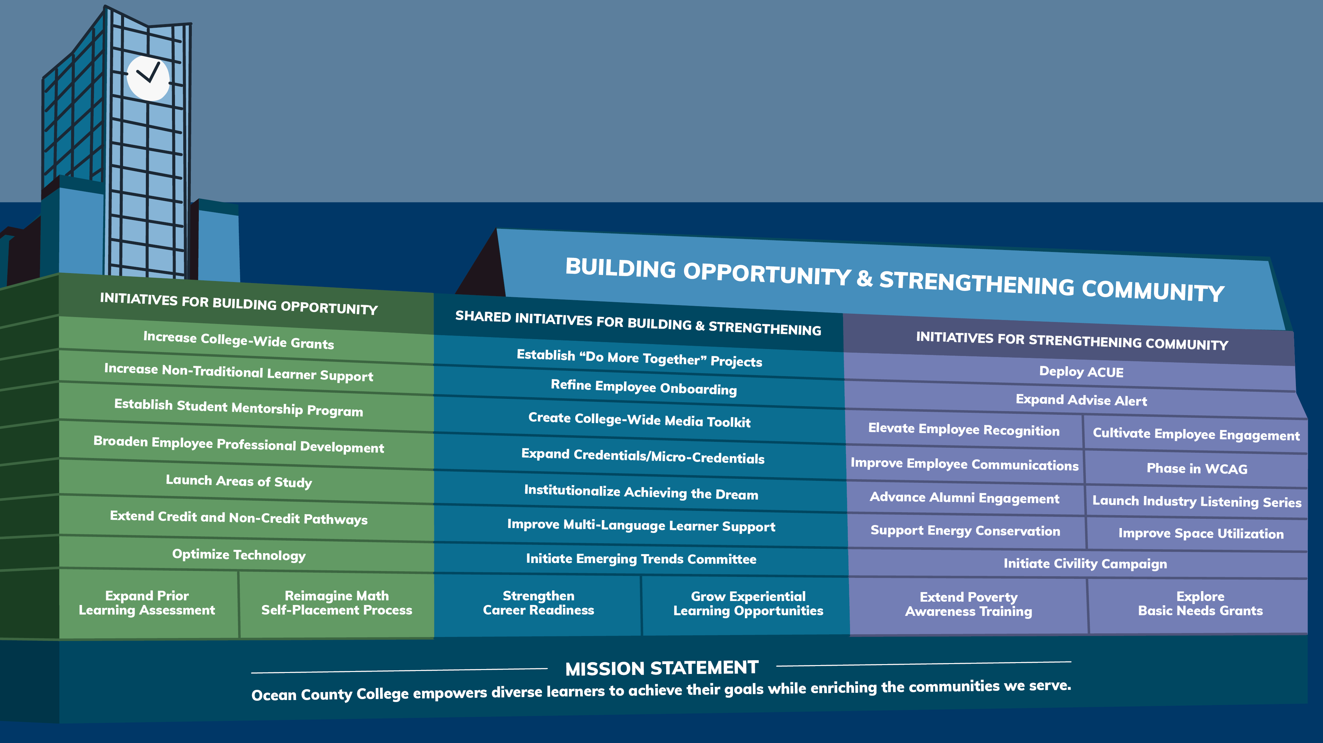
Building Opportunity and Strengthening Community

Slide 47
Strengthening Community Initiatives
Expand Advise Alert
Deploy ACUE
Improve Employee Communications
Phase In WCAG
Elevate Employee Recognition
Cultivate Employee Engagement
Initiate Civility Campaign
Extend Poverty Awareness Training
Explore Basic Needs Grant
Advance Alumni Engagement
Launch Industry Listening Series
Support Energy conservation
Improved Space Utilization

Slide 48
Building & Strengthening Initiatives
Improve Multi-Language Learner Supports
Grow Experiential Learning Opportunities
Strengthen Career Readiness
Expand Credentials/Micro-credentials
Refine Employee Onboarding
Create College-wide media toolkit
Institutionalize Achieving the Dream
Initiate Emerging Trends Committee
Establish “Do More Together” Project

Slide 49
Building Opportunity Initiatives
Broaden Employee Professional Development
Increase Non-traditional Learner Support
Reimagine Math self-Placement Process
Expand Prior Learning Assessment
Extend Credit and Non-Credit pathways
Optimize Technology
Establish Student Mentorship Program
Launch Areas of Study
Increase College-Wide Grants

